Slide 1
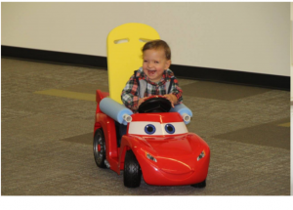
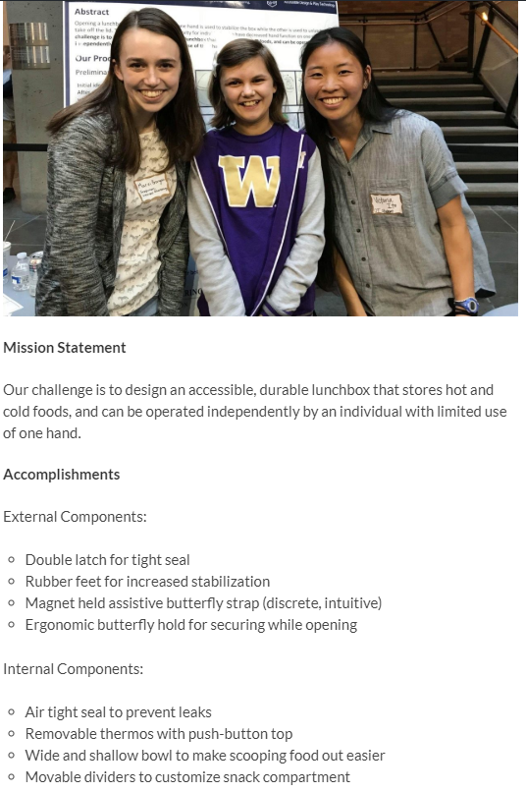
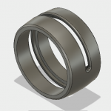
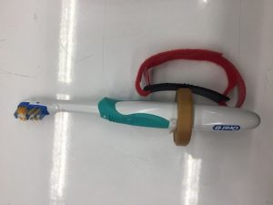
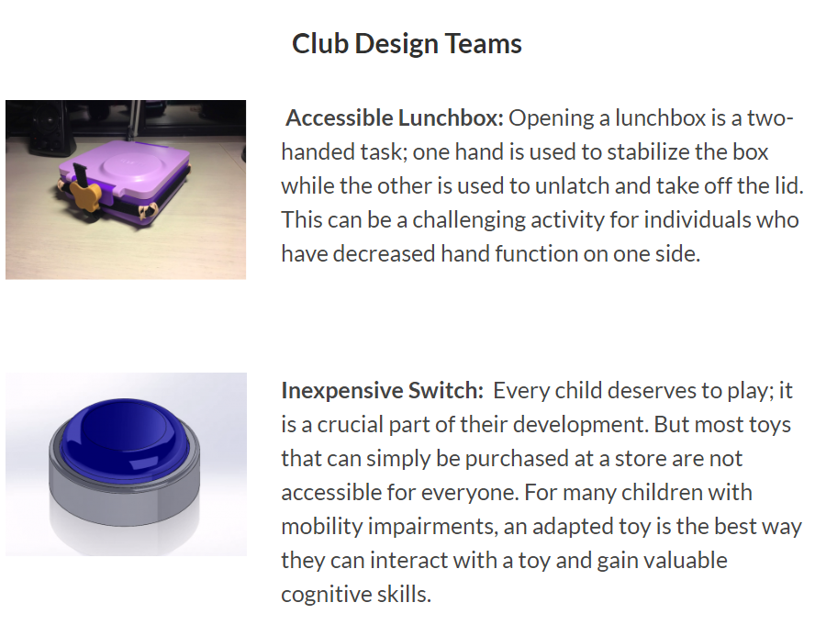
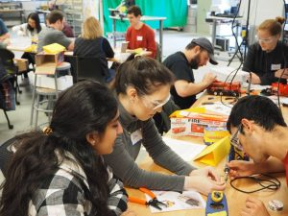
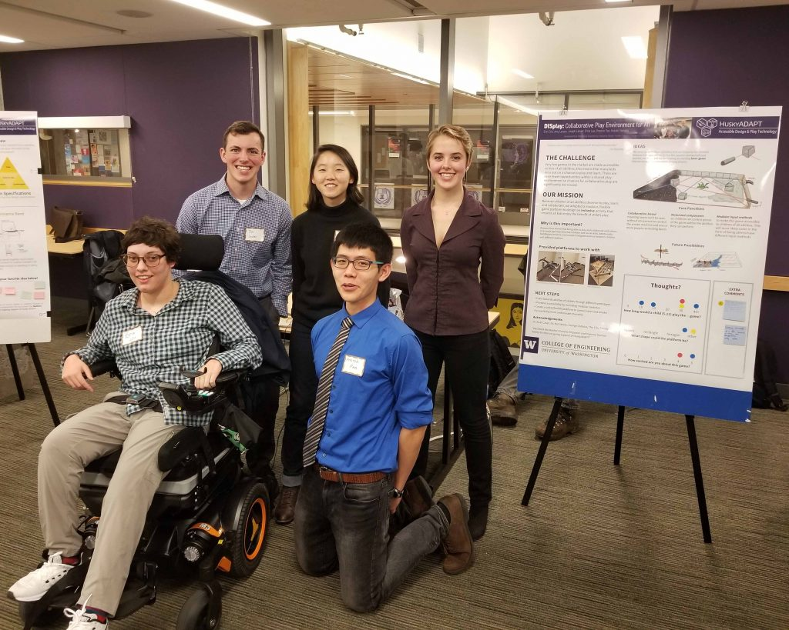
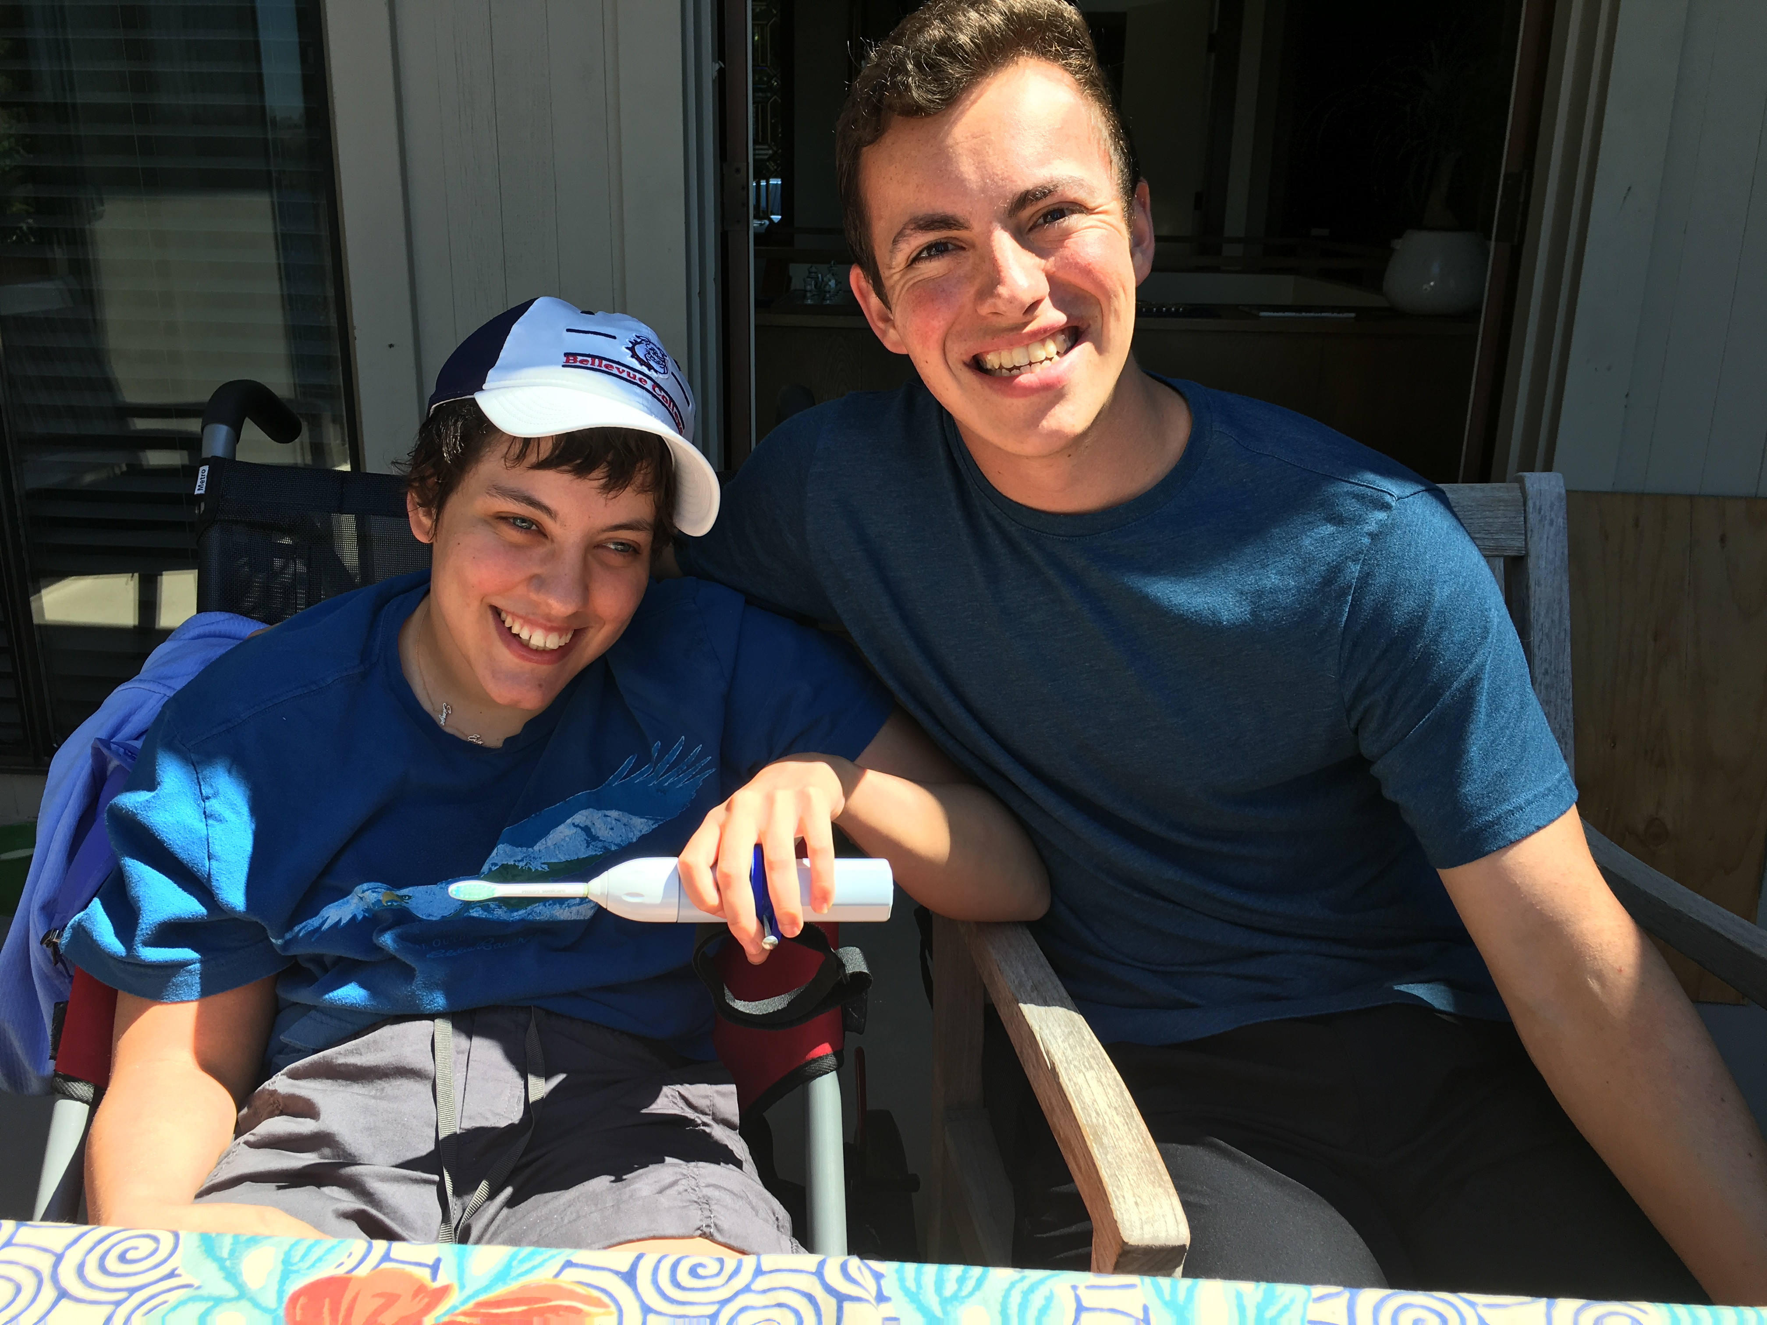
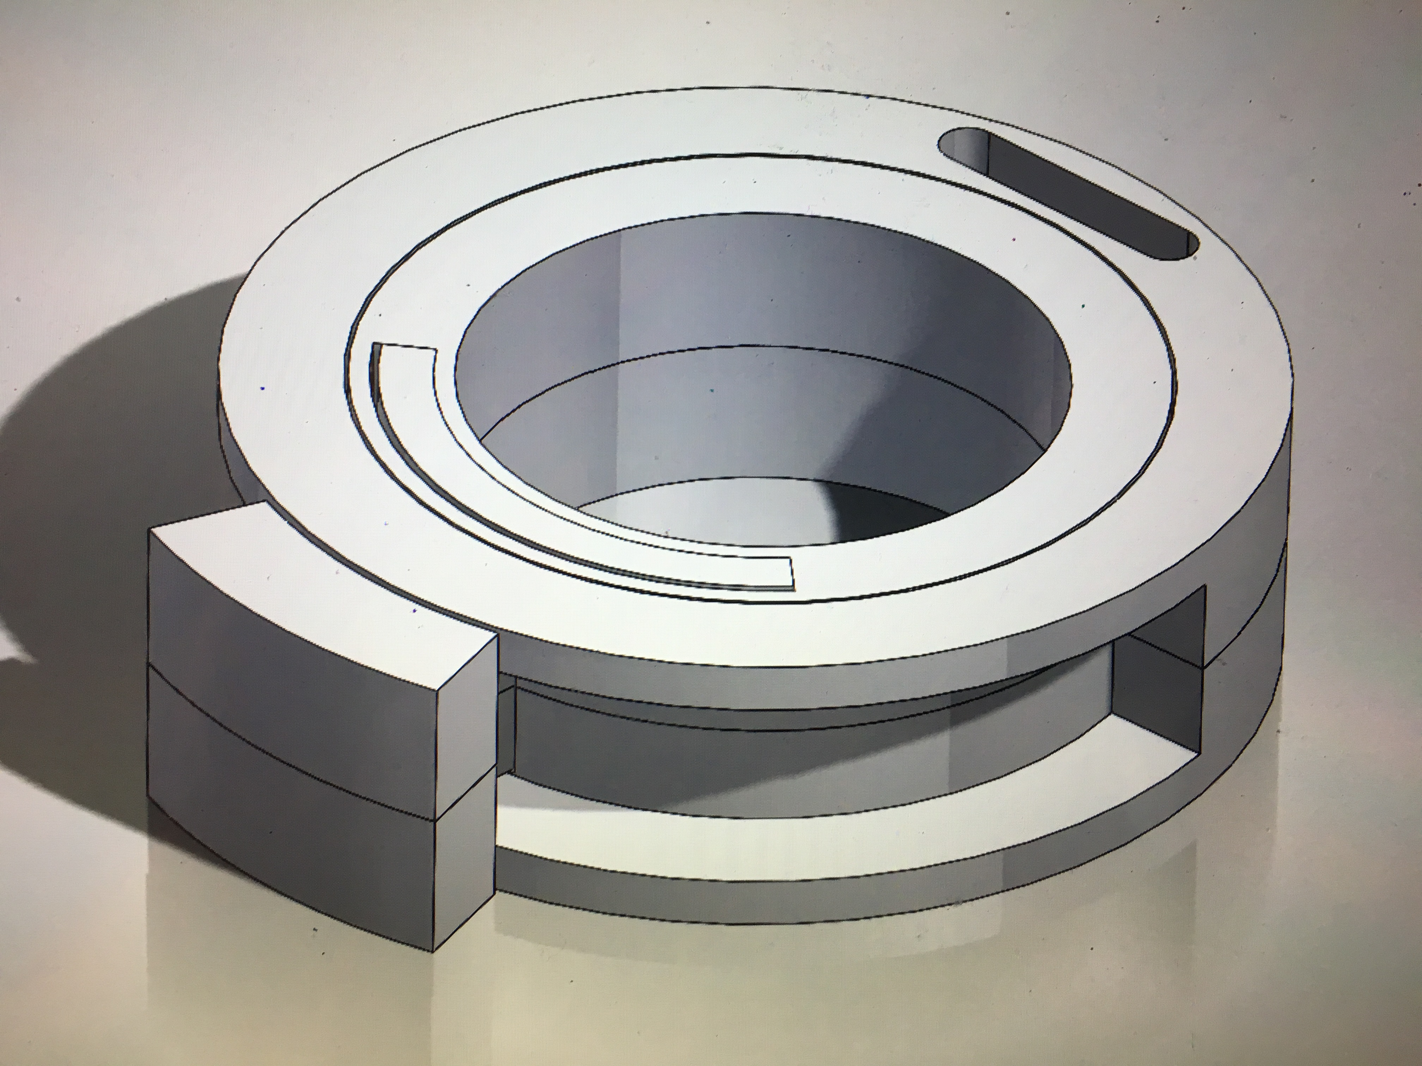

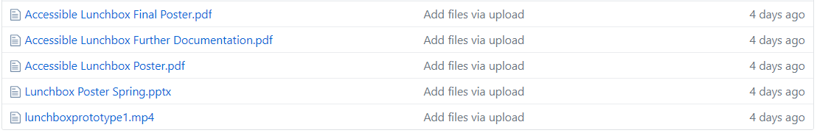
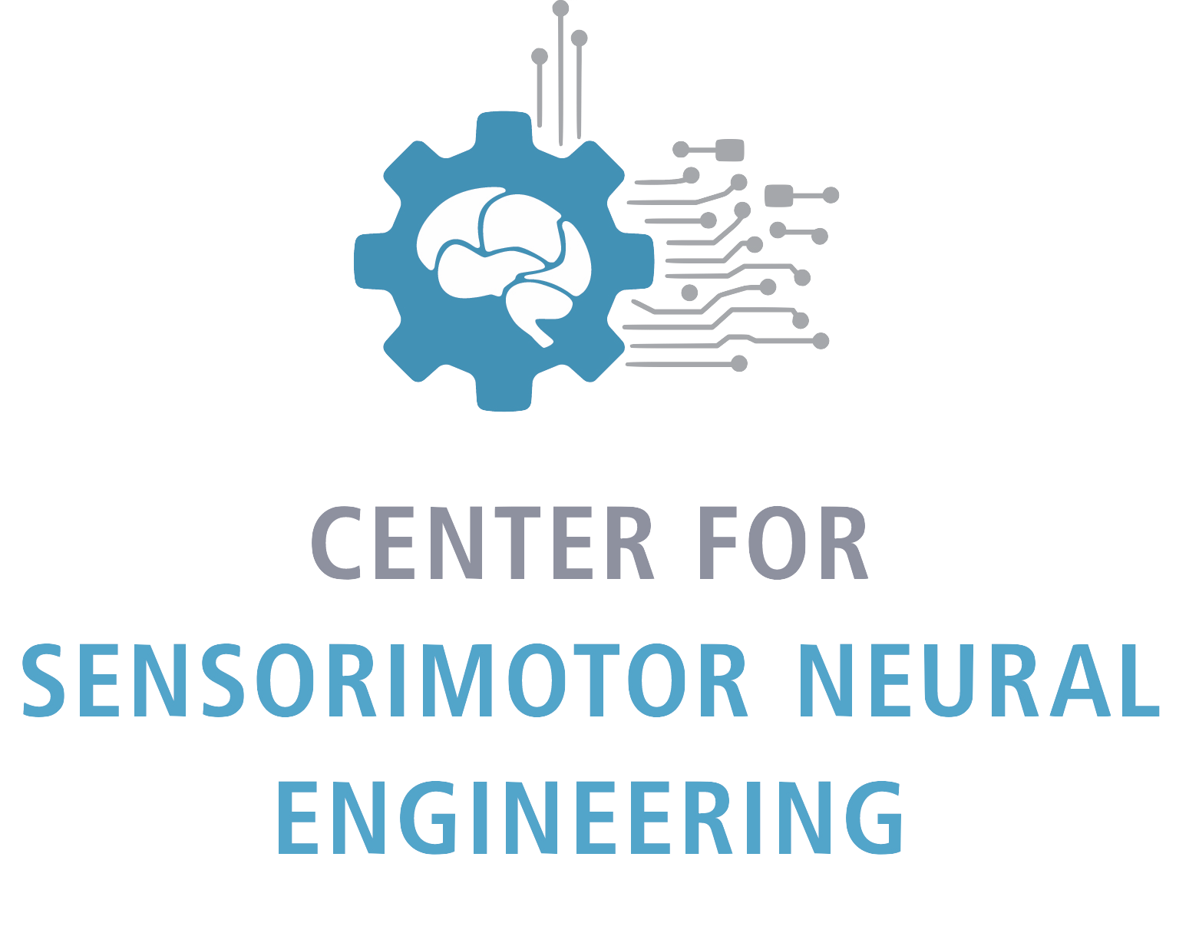
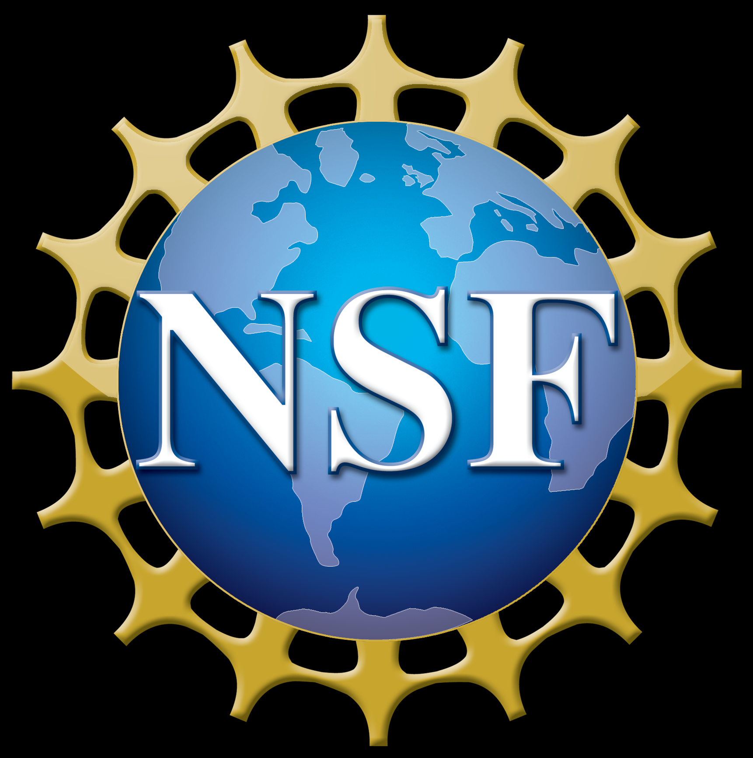

Size of font
Establishing an inclusive and sustainable design program for assistive technology
Joseph J. Lawler, Keshia M. Peters, Alyssa M. Spomer and Katherine M. Steele
Mechanical Engineering, University of Washington, Seattle, WA
What is Husky ADAPT?
What is Accessible Design?
What makes a program sustainable?
Husky ADAPT stands for Accessible Design and Play Technology; the program just completed its first year and is already incredibly successful
A program at the University of Washington where teams of students pair with local individuals with disabilities to take on design projects
A design process in which the needs of people with disabilities are specifically considered [1]
Focused on preservation and transfer of information
Information is organized in a way allowing others to learn, replicate and iterate upon our work
Design Projects 2017-2018
Furthering a Design Project
Design Challenges 2018-2019
How do we ensure sustainability of projects between years? How do we share results with the broader community?
How can we help individuals with limited hand function perform daily hygienic tasks?
How do we reach out to need experts for design project ideas and partnerships? How do we pick design projects for impact?
Need:
A website that ensures the sustainability of the club and showcases past accomplishments
Process:
Performed case studies on research pages
Posted mission statement, accomplishments, next steps and GitHub repository for each team
Incorporated accessibility features
Product:
Need:
A modular system that allows individuals with varying dexterity foster greater independence in their daily life, specifically to manipulate a toothbrush
Product:
Team Cajun created a tool that allows the user to effectively manipulate a variety of objects
Final design allows full rotation laterally and a centrifugal rotation of 270 degrees
Thin lightweight design
offering maximum mobility
Continuation:
Design a tool specifically for need expert Erin Ciliv
A need expert is a community member who provides invaluable insight on a particular disability
Iterated multiple times based off user feedback
Device builds upon Erin's ability with her left hand; rotates toothbrush 180 degrees
Need:
System for reaching out to need experts and creating design challenges for next year
Product:
Survey is inclusive and sets expectations for need experts and teams; incorporated feedback from experts in the field
Centralized repository of community members contact information
Interview document for meetings with need experts to ensure the correct information is gathered
One page summary of each design challenge for incoming student teams providing more direction and detail
Central Page for teams; images link to detailed team pages
Mouseover hover feature
Future:
Documentation will be used in upcoming meetings, continue to iterate upon the format based off of feedback
Expand our network of community members, continuing to increase Husky ADAPTs impact
Alternative Text
The website workflow is now more intuitive and organized so the information is accessible. Future teams will also be able to upload their work, making the program sustainable.
Building upon team Cajuns work, I was able to design a similar device specifically for need expert Erin Ciliv. Erin now has the ability to brush her teeth with just her left hand.
Student teams and need experts are set up for success by establishing realistic expectations and desired outcomes before the design process even starts.
References
1. Washington.edu. (2018). What is the difference between accessible, usable, and universal design? | DO-IT
Acknowledgments
I would like to thank Erin Ciliv and her family, the Husky ADAPT student faculty for their advice and direction throughout this project. I also thank the Mathers Fund to Empower and Improve Human Ability for their ongoing support of HuskyADAPT.

